Slide 1
Awareness about Indian Constitution
Project by-
190030045, ALAPARTHI SAI SREE 190030351, SAHITHYA DACHEPALLI 190030944, LINGAMAGUNTA NAGA VEENA

Slide 2
Index
Title of the Project
Objective of the Project
Problem Statement
Proposed Solution
Ideas
Modules
Requirements
Usercases

Slide 3
Prominent Constitution
~A constitution for the people, by the people, of the people…

Slide 4
Objective of the Project
To create awareness about the constitutional values and objectives written in the Indian Constitution.
To ascertain the views of student teachers regarding the achievement made in respect of each of the values /objectives in the present context in India.

Slide 5
Problem Statement
The Constitution of India is the supreme law of India. The document lays down the framework that demarcates fundamental political code, structure, procedures, powers, and duties of government institutions and sets out fundamental rights, directive principles, and the duties of citizens.
It imparts constitutional supremacy (not parliamentary supremacy, since it was created by a constituent assembly rather than Parliament) and was adopted by its people with a declaration in its preamble. Parliament cannot override the constitution.
It was adopted by the Constituent Assembly of India on 26 November 1949 and became effective on 26 January 1950.

Slide 6
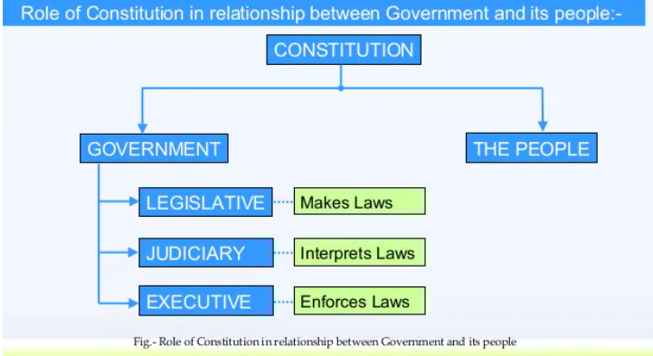

Slide 7
Proposed Solution
Firstly we want to conduct a survey about how many people of our country about fundamental rights they have or at least know preamble of Indian Constitution.
Making people to know about the significance of the Constitution to it’s citizens.
We have to make people know about
fundamental rights,
What distinguishes a Constitution from Laws Made by the Legislature,
How can a constitution protect individuals’ rights,
How do the Government and Courts Function etc
Project will have to be divided into modules and right layout and design should be selected.

Slide 8
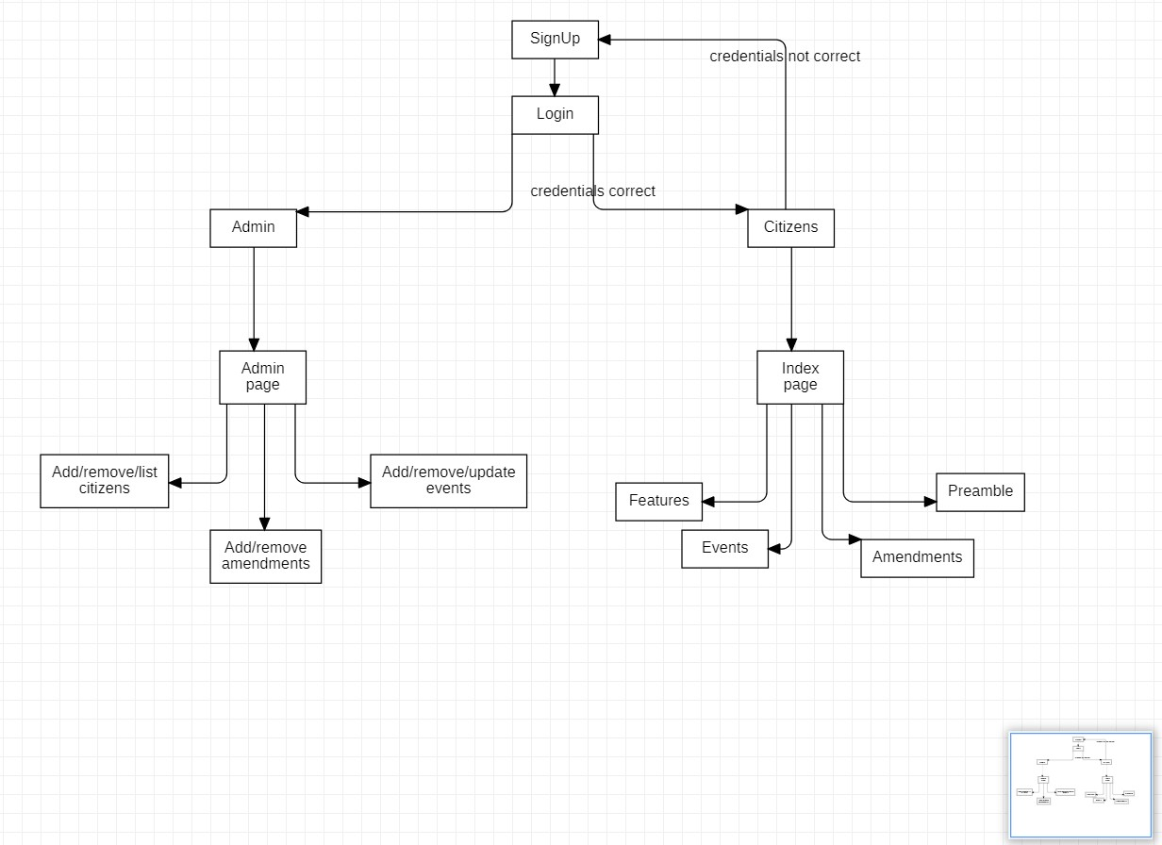
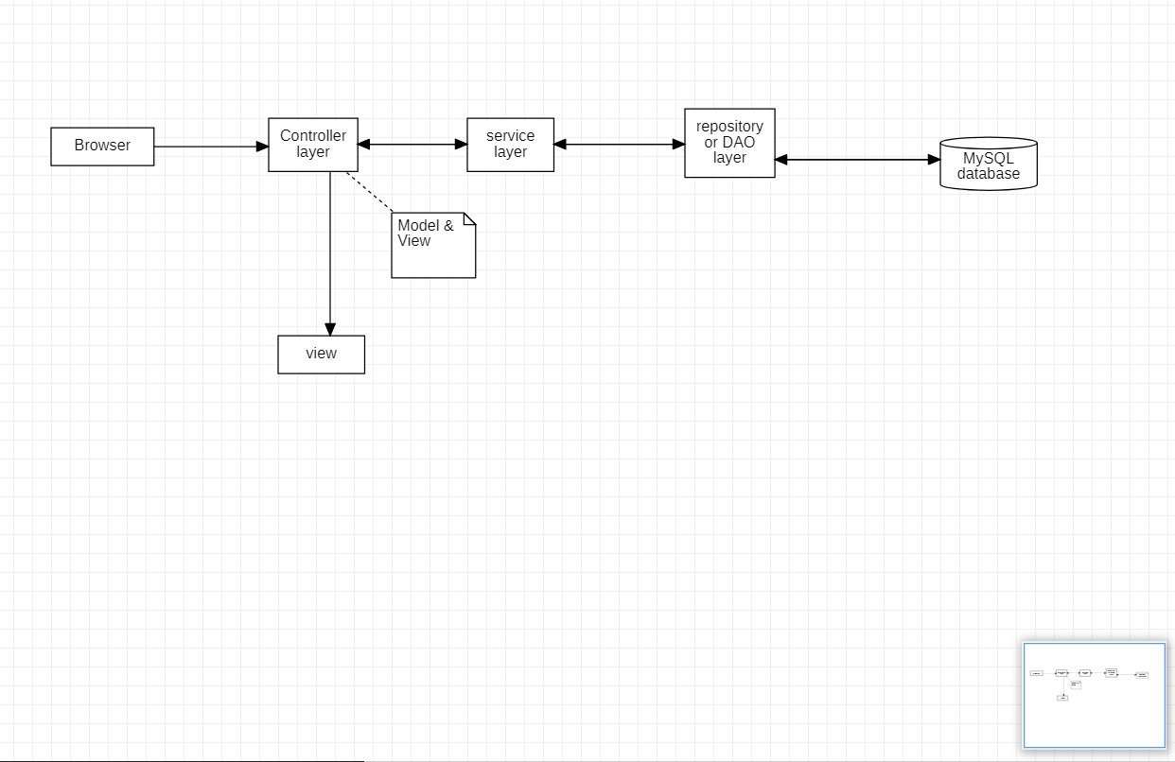
Block Diagram

Slide 9
Modules
Donation page
Module 4
Module 3
Login Page
Module 1
Events Page
Index Page
Module 2

Slide 10
Login Page
Login page is a portal where both admin and normal citizen i.e, user can login.
But according to given credentials it redirects each of them respectively.
Operations of admin and citizen are different from each other as follows
Admin
Admin can work on add retrieve of users
Admin can work on new updates and new features of website
Admin can change the information
Citizen
It displays an ID number and Password form.
It also provides a link for forgotten password.
After login with correct information, it will redirect to index page.
First module of project

Slide 11
Index Page
In index module user will be able to get information like about amendments, preamble and a detailed information about key features of constitution.
Amendments
The Indian Constitution is not a rigid constitution. It can be amended by the Parliament following a few rules.
There have been made many changes in the Constitution of India. Some of the important amendments of the Indian Constitution.
Premable
The Preamble is basically the introduction or preface to the constitution. It sums up the essence of the constitution.
N A Palkhivala, a constitutional expert, referred to the Preamble as the ‘Identity card of the Constitution’.
The Preamble has been amended in 1976 by the 42nd Amendment which added words ‘socialist’, ‘secular’ and ‘integrity’ to it.
Key Features of Indian Constitution
Federalism
Parliamentary Form of Government
Separation of Powers
Fundamental Rights
Secularism
Second module of project

Slide 12
Events Page
To bring awareness about Indian constitution , many NGO’s and different organizations do conduct many events.
This events page will notify the citizens about those events that are held in different places.
It allows citizen to know about different events and if interested to participate then it gives venue of the event.
Events page allows admin to add those events.
Third Module of project

Slide 13
Donation Page
Funds are essential to continue striving toward our mission.
Donations can produce additional revenue for our awareness program.
Donation Page allows the citizen to support the organization which is putting there to bring awareness.
Also a citizen can donate willful amount to the connected NGO’s or organizations that are helping.
After donation, citizen will be getting conformation through an email and can also get receipt of payment.
Admin will be able to get those payments and list of all other citizens payments.
Last module of project

Slide 14
Technology we want to use
Software Requirements
Spring tool suites/Eclipse ide
Tomcat 8 server
Mysql/ oracle for database
Jdk 1.8 version
Hardware Requirements
Laptop with Eclipse /Spring tool

Slide 15
Use Cases
As a admin, I want to login successfully into website.
As a admin, I want to store data from external resources.
As a admin , I must be able to get transactions data that are done by users.
As a admin, I must be able to notify users about events so that users can see them.
As a user, I must be able to login into website.
As a user, I must be able to do donations successfully.
As a user, I must be able to access different modules of website.
As a user , I must be able to successfully save my previous work and logout.

Slide 16
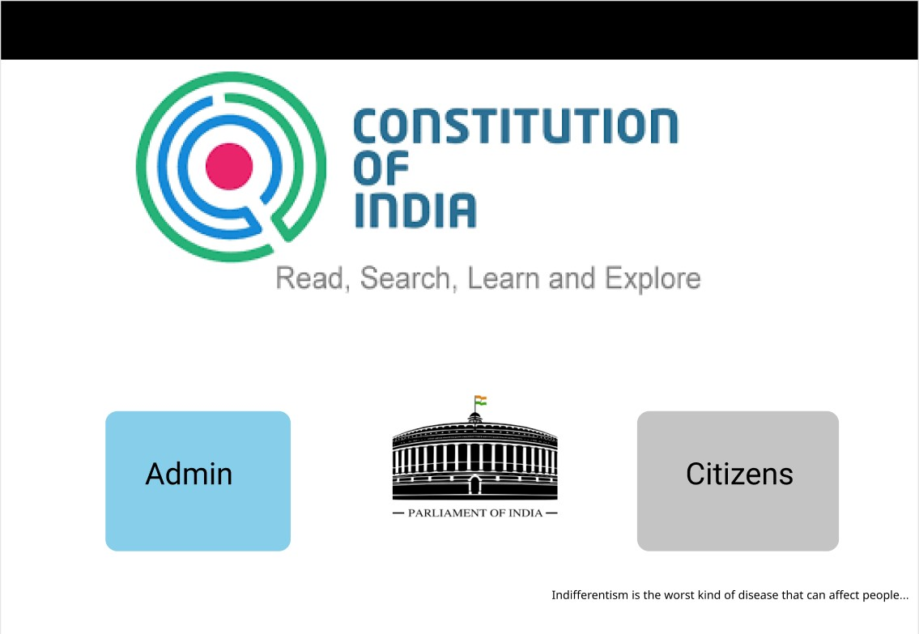
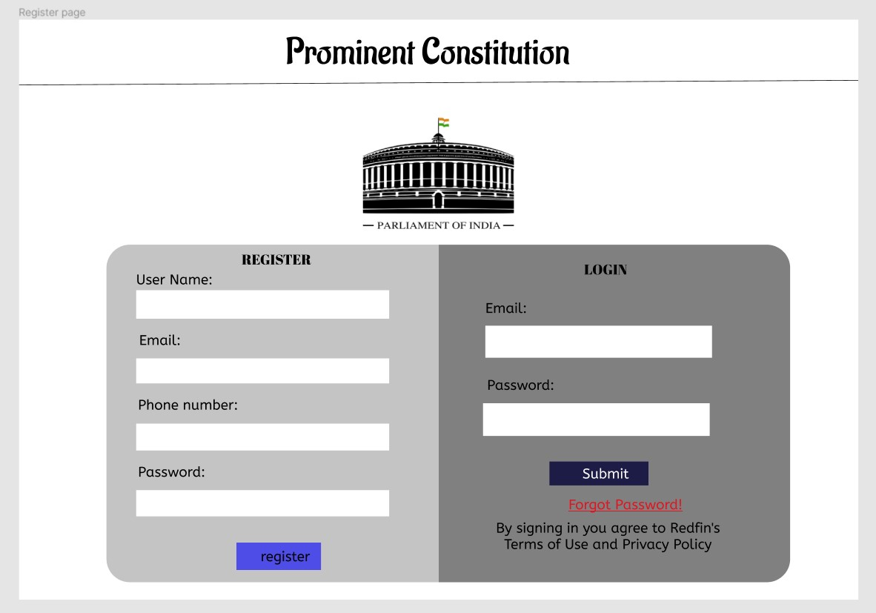
Prototype screenshots

Slide 17
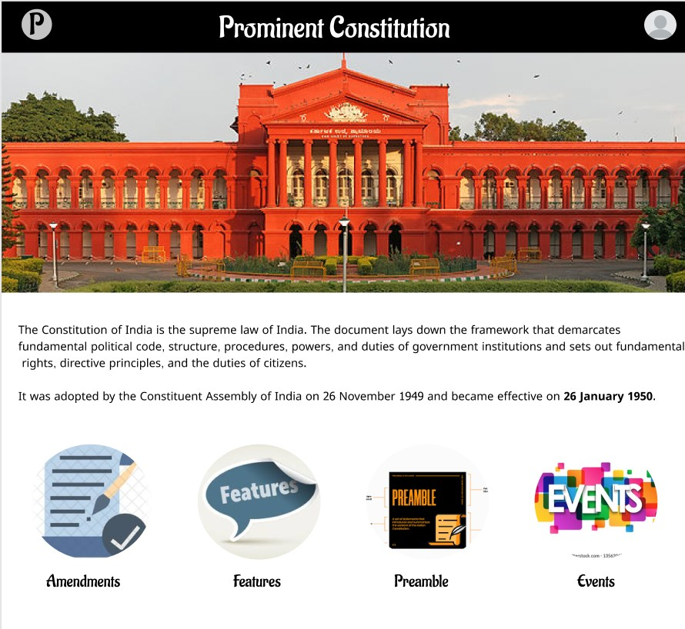
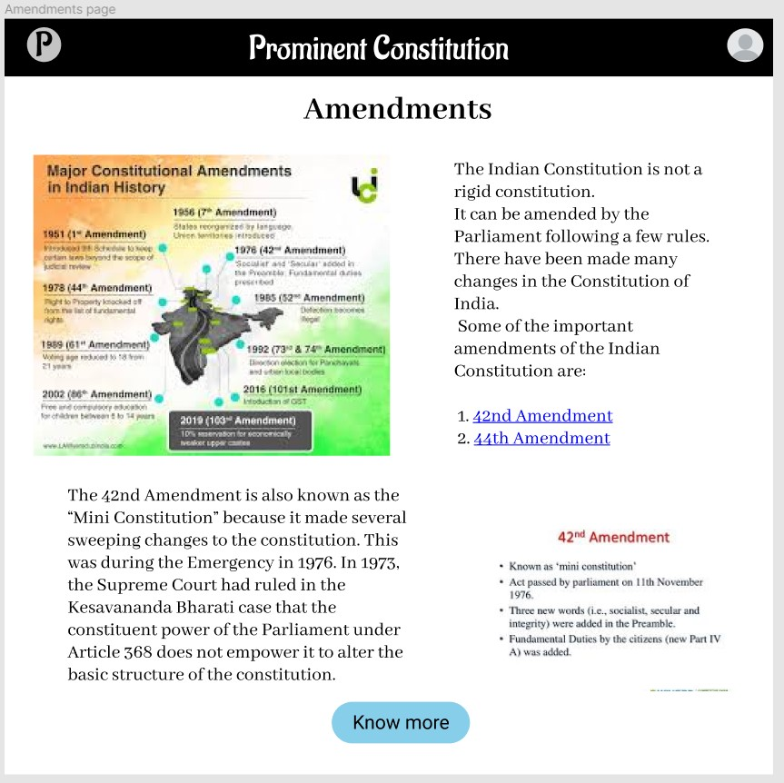

Slide 18
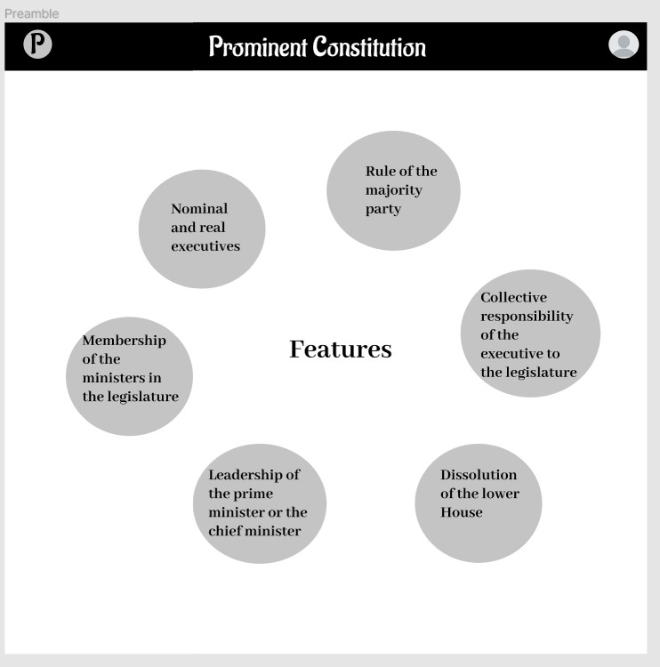
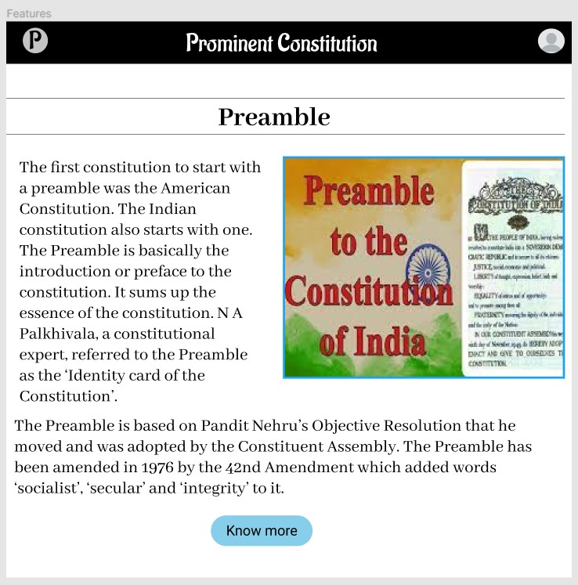

Slide 19
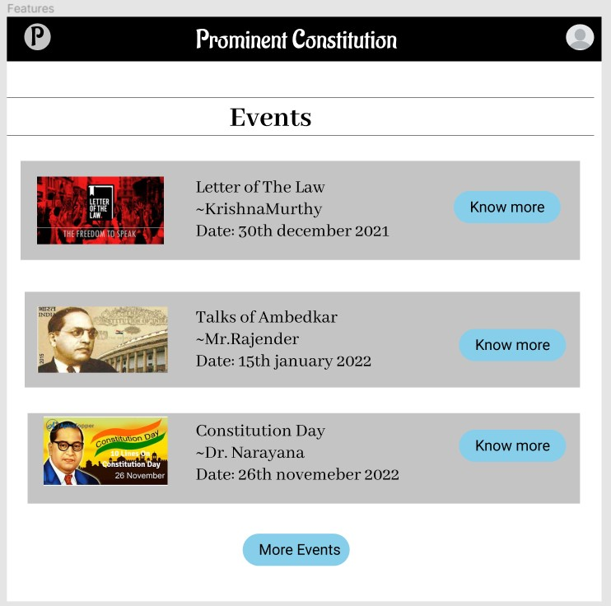

Slide 20


